Slide 1
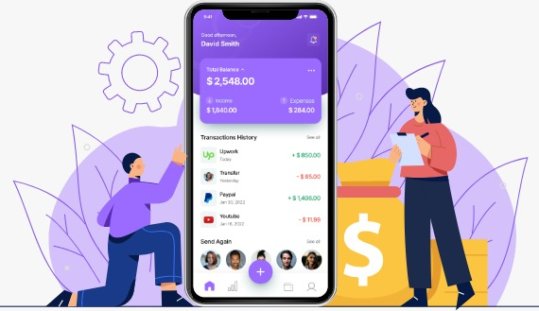
Expense Tracker
Nishita Patel - 12302080601089
Krishna Patel - 12302080601094
Rahi Patel - 12302080601095
Notes:
Title slide.

Slide 2



INTRODUCTION
The Expense Tracker is a simple mobile application for recording daily expenses and keeping spending within a monthly budget.
Record
Track
Keep
Add expenses with a title, amount and category.
See total spent and remaining budget at a glance.
Data is stored on the device and restored on reopening.
2

Slide 3




PROBLEM STATEMENT
People often find it difficult to remember their daily expenses.
Manual expense records can be time-consuming and difficult to maintain.
Without proper tracking, users may exceed their budget.
It can be difficult to identify where money is being spent.
Therefore, a simple mobile application is needed to record expenses and monitor budget usage.
3

Slide 4
OBJECTIVES
Record daily expenses quickly with categories
01
Calculate total spent and remaining budget automatically
02
Let users set and update a budget
03
Keep saved records available after restarting the app
04
4

Slide 5




TECHNOLOGY STACK
React Native
TypeScript / JavaScript
Visual Studio Code
Framework used to build the mobile application interface.
Used to implement app logic, calculations, and user interactions.
Used to write and manage the project code.
Android SDK and Gradle
AsyncStorage
Used to build, install, and run the app on the Android emulator.
Stores expense records and the budget locally on the device.
5

Slide 6
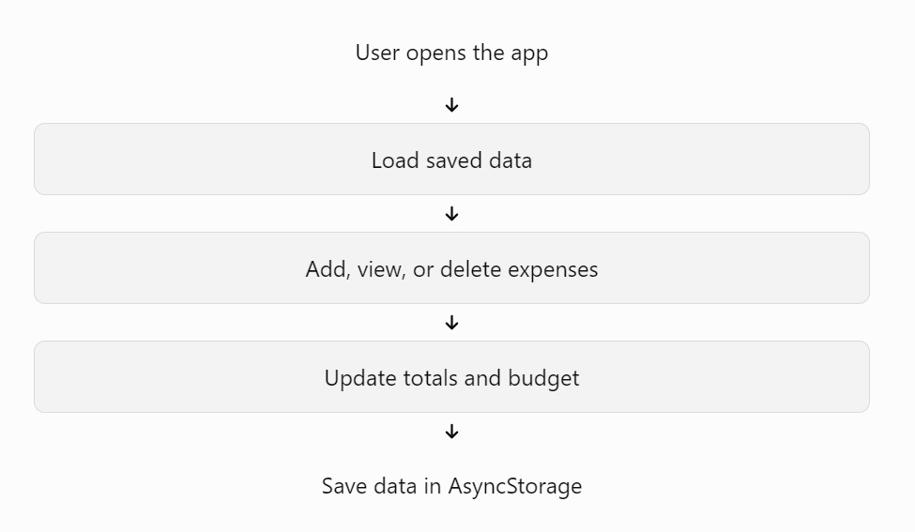
APPLICATION WORKFLOW
Working of the application:
1. The user opens the Expense Tracker app
2. The app loads saved expenses and the budget from local storage
3. The user adds an expense by entering its title, amount, and category
4. The application updates the total spent and remaining budget
5. The expense list is updated on the screen
6. Changes are saved using AsyncStorage
6

Slide 7








MAJOR FEATURES
Add Expense
Expense Categories
Total Spent
Budget Management
Enter the expense title, amount, and category.
Food, Transport, Education, Shopping, Entertainment, Bills, and Other.
Automatically calculates the total of recorded expenses.
Allows the user to set or update a budget.
Remaining Budget
Delete Expense
Local Data Storage
Expense List
Shows the amount left after expenses.
Removes an expense from the list.
Keeps saved records available after restarting the app.
Displays recorded expenses with relevant details and icons.
7

Slide 8
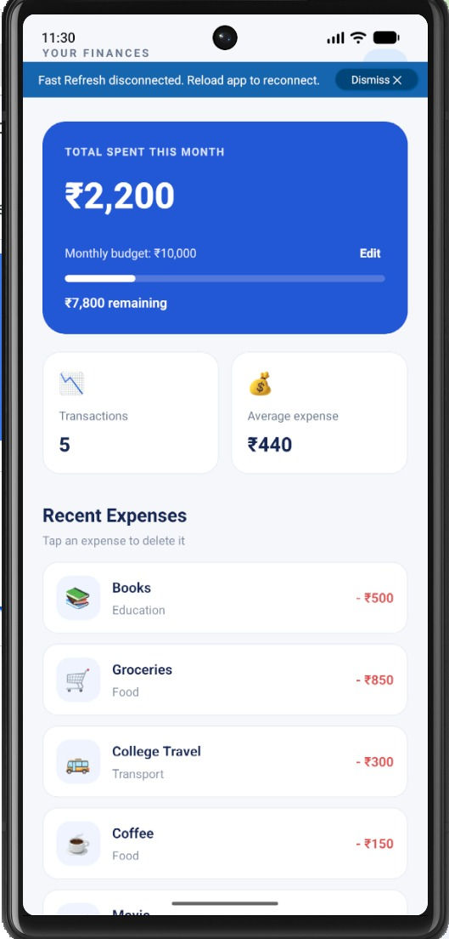
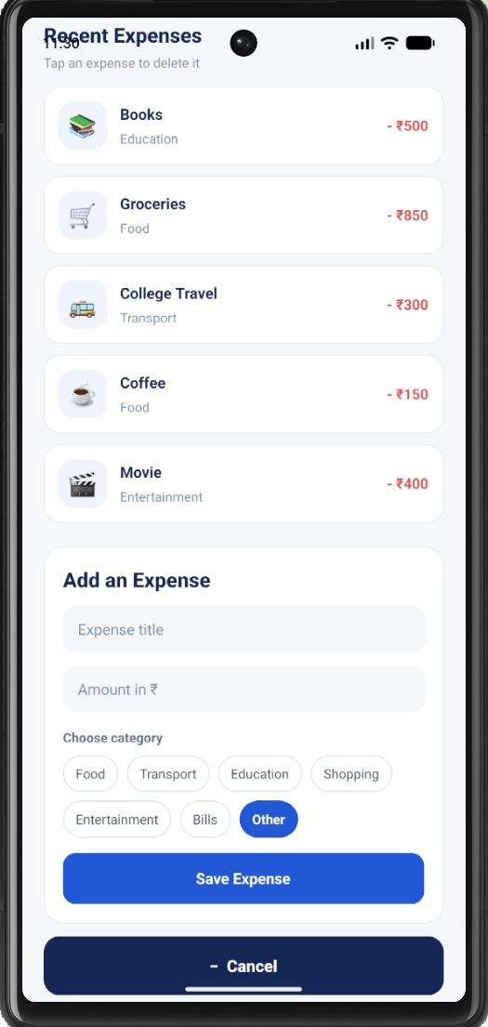
USER INTERFACE & SCREEENSHOTS
Home Dashboard
Total spent, monthly budget, remaining amount, transaction count, average expense and recent expenses.
Add Expense Form
Enter a title and amount in ₹, choose a category, then save the expense.
8

Slide 9
TESTING & RESULTS
Test case | Expected result
Open the application | Home screen loads
Add an expense | Expense appears in the list
Delete an expense | Selected expense is removed
Update the budget | New budget is displayed
Close and reopen the app | Saved data is restored
Add multiple expenses | Total spent updates correctly
Results
The application runs on the Android emulator.
Users can manage expenses through the mobile interface.
Spending totals and remaining budget are calculated automatically.
9

Slide 10
CONCLUSION & FUTURE SCOPE
Conclusion
Future Scope
The Expense Tracker successfully demonstrates the development of a mobile application using React Native.
It simplifies recording and managing daily expenses.
It calculates spending totals and remaining budget.
AsyncStorage provides local data persistence.
The project demonstrates mobile UI development, state management, calculations, and storage.
Add monthly and yearly expense reports.
Include charts and spending analysis.
Add cloud backup and user authentication.
10

